Slide 1

DESIGN AND ANALYSIS OF ALGORITHMS
Dr. Kashif Ayyub

Slide 2
The RAM Model of Computation
Two common tools used for algorithm analysis are the RAM model of computation and the asymptotic analysis of worst-case complexity.
The RAM (Random Access Machine) model is used for analyzing algorithms without running them on a physical machine.
A simple operation (+, -, *, /, =, if) takes one time step.
Loops and subroutines are comprised of simple operations.
Memory is unlimited and access takes one time step (the RAM model does not consider whether data is on cache or disk).
Using the RAM model, you measure the running time of an algorithm by counting the number of steps an algorithm takes on a given input.

Slide 3
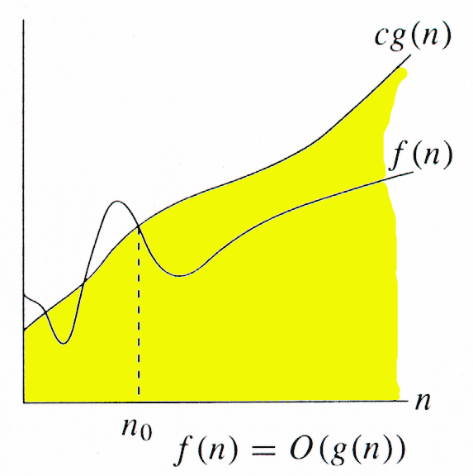
Big-O: Asymptotic Upper Bound
The notation Ο(n) is the formal way to express the upper bound of an algorithm's running time. It is the most commonly used notation. It measures the worst case time complexity of an algorithm.
Asymptotic Less than and Equal
For function g(n), we define O(g(n)), big-O of n, as:
Set of all functions whose rate of growth is the same as or lower than that of g(n).
g(n) is an asymptotically upper bound for f(n).
f(n) ≤ g(n)

Slide 4
Big-O: Example
20n³ + 10nlgn + 5 = O(n³)
3lgn + lg(lgn) = O(lgn)
2100 = O(1)

Slide 5
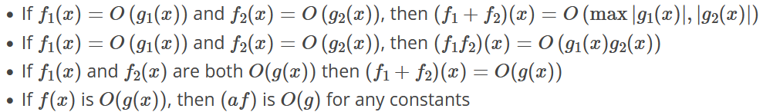
Big-O: Properties

Slide 6
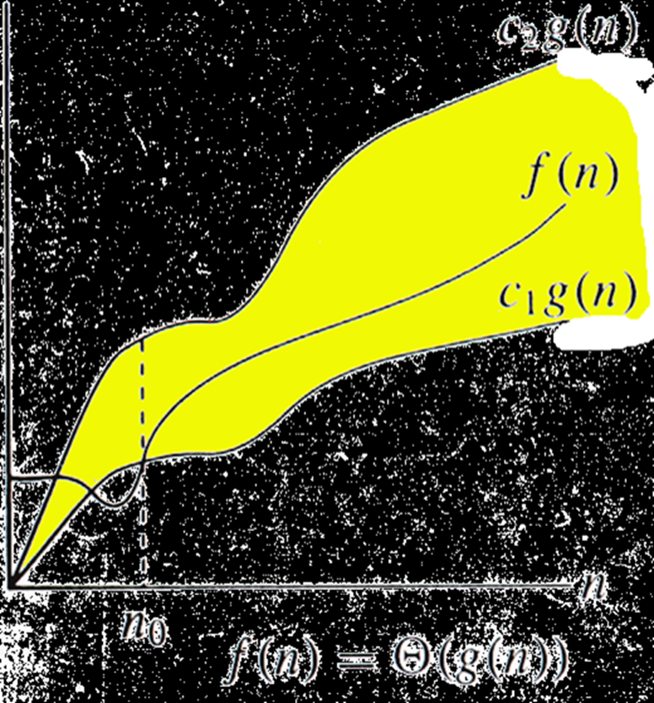
Big-Θ: Asymptotic Tight Bound
Asymptotic Equality
For function g(n), we define Θ(g(n)), big-Theta of n, as:
Set of all functions that have the same rate of growth as g(n).
g(n) is an asymptotically tight bound for f(n).
f(n) = g(n) old concept
f(n) ∈ g(n) new concept

Slide 7
Big-Θ: Example
Θ(n³): n³
5n³+ 4n
105n³+ 4n² + 6n
Θ(n²): n²
5n²+ 4n + 6
n² + 5
Θ(log n): log n
log n²
log (n + n³)

Slide 8
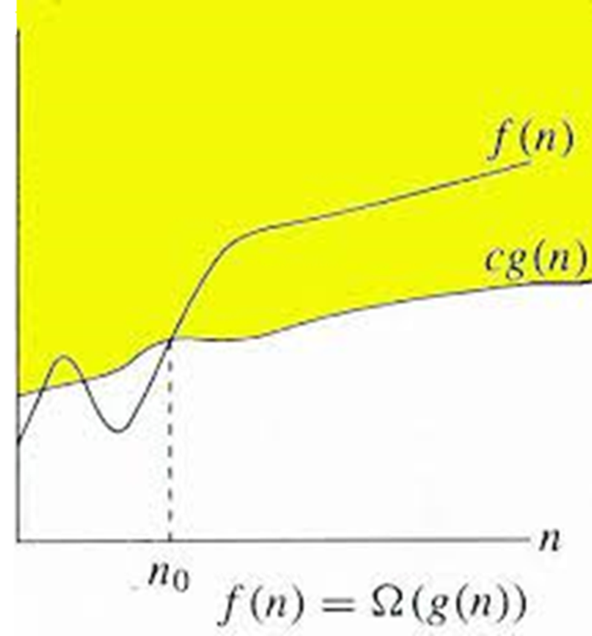
Big-Ω: Asymptotic Lower Bound
Asymptotic Lower Bound
For function g(n), we define Ω(g(n)), Omega of n, as:
Set of all functions whose rate of growth is the same as or higher than that of g(n).
g(n) is an asymptotically lower bound for f(n).
f(n) ≥ g(n)

Slide 9
Big- Θ: Example
Θ(n³): n³
5n³+ 4n
105n³+ 4n² + 6n
Θ(n²): n²
5n²+ 4n + 6
n² + 5
Θ(log n): log n
log n²
log (n + n³)

Slide 10
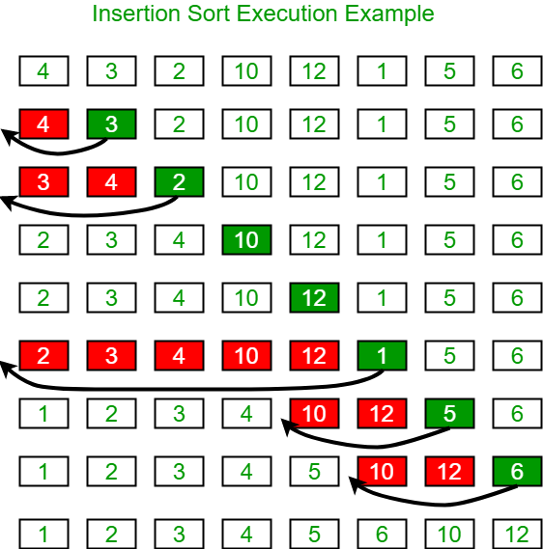
Time and Space Complexity of Insertion Sort
To sort an array of size N in ascending order iterate over the array and compare the current element (key) to its predecessor, if the key element is smaller than its predecessor, compare it to the elements before.
Move the greater elements one position up to make space for the swapped element.

Slide 11
Time Complexity of Insertion Sort
Best Case: O(N)
The best-case time complexity of Insertion Sort occurs when the input array is already sorted.
Each element is compared with its preceding elements, resulting in a linear time complexity.
Average Case: O(N²)
This complexity arises from the nature of the algorithm, which involves pairwise comparisons and swaps to sort the elements.
Although the exact number of comparisons and swaps may vary depending on the input, the average-case time complexity remains quadratic.
Worst Case: O(N²)
When the input array is in reverse sorted order.
In this scenario, each element needs to be compared and possibly swapped with every preceding element, resulting in a quadratic time complexity.

